Slide 1
Week 9 Diversity in workplace
COMU7311, Semester 1, 2021
School of Communication and Arts, UQ

Slide 2
Learning objectives
After this lecture, you should be able to:
Identify Hofstede’s cultural dimensions, and their application in workplaces.
Describe Hall’s high-context and low-context cultures.
Apply Hofstede’s and Hall’s work in workplace contexts.

Slide 3
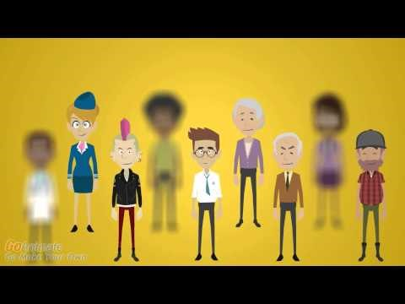
Diversity in workplaces https://www.youtube.com/watch?v=uHYuDDHvU64

Slide 4
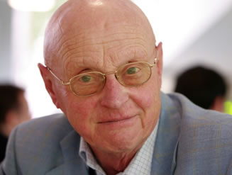
Hofstede’s cultural dimensions
Geert Hofstede categorised cultures by five dimensions, which are continuous and varying in degrees.
Hofstede surveyed employees of IBM and its subsidiaries in over 50 countries and regions.
See Required reading this week.

Slide 5
Individualism versus collectivism
In individualistic cultures
- emphasise individuals’ goals, abilities and aptitudes over those of the group.
Collectivistic cultures
- Serve and preserve the ingroup by subordinating personal goals.
Can cultures be both individualistic and collectivistic?

Slide 6
Implications for leadership
Members in individualist cultures generally respond well to material rewards that honour individual effort. In collectivist cultures, people prefer team rewards.
Members of collectivist cultures expect mutual loyalty between managers and employees.
To be accepted, new ideas in collectivist cultures must come from the group rather than from any individual.
Decision making is identified with a single leader in individualistic cultures and with the group in collectivist cultures.

Slide 7
Masculinity versus femininity
In masculine cultures, people strive for maximal distinction between gender roles and expectations; greater value is placed on masculine traits.
Cultures labelled as feminine permit more overlapping social roles for the sexes and place high values on feminine traits.

Slide 8
Implications for leadership
Females in masculine cultures have a harder time emerging as leaders and are more likely to be segregated into a few specialised jobs.
Leaders in masculine cultures put a higher priority on work; in feminine cultures more emphasis is on the quality of life.
Leaders in feminine cultures are more likely to demonstrate an interpersonally oriented leadership style.

Slide 9
Uncertainty avoidance
This dimension reflects a culture’s tolerance of ambiguity and acceptance of risk.
In high uncertainty avoidance cultures, members seek for information and certainty, and are actively security seeking.
In low uncertainty avoidance cultures, members are more comfortable dealing with diversity, ambiguity and risk.

Slide 10
Implications for leadership
Members in high uncertainty avoidance cultures prefer clear instructions, are more willing to follow orders, disapprove of competition between employees, and are more loyal than their low uncertainty avoidance counterparts.
Managers in low uncertainty avoidance cultures are more willing to take risks.

Slide 11

Power distance
Power distance is related to the level of hierarchy in a society.
Could you give an example to show in what ways communication can reinforce the power distance between people?

Slide 12
Implications for leadership
The larger the power distance between managers and employees, the greater the fear of disagreeing with a superior and the closer the supervision of employee activities.
Authoritarian leadership is more common in high power distance countries; democratic leadership is more often the norm in low power distance cultures.
Power for companies operating in low power distance cultures are less centralised.

Slide 13
Long-term and short-term orientations
Long-term orientation encourages thrift, savings, perseverance toward results, and a willingness to subordinate oneself for a purpose.
Short-term orientation is consistent with spending to keep up with social pressure, less savings, and preference for quick results.

Slide 14
Implications for leadership
Managers with Long-term orientation tend to be future-focused. They value persistence, perseverance, saving and being able to adapt.
Managers of Short-term orientation tend to be focused on the present. They care more about immediate gratification than long-term fulfilment.
Managers who know the time orientation of their employees will be able to use motivating incentives that align with their orientations, such as a bonus - a short-term incentive - or an additional contribution to an employee's retirement fund, which is a long-term orientated incentive.

Slide 15
Indulgence and restraint
Indulgence stands for a society that allows relatively free gratification of basic and natural human desires related to enjoying life and having fun.
Restraint stands for a society that controls gratification of needs and regulates it by means of strict social norms.
Cultures high in indulgence orientation are found to place importance on freedom of speech, leisure, and personal life control, whereas cultures high in restraint tend to place higher value on stricter social norms.

Slide 16
Implications for organisations
Research found that indulgence orientation tends to prevail in South and North America, Western Europe, and parts of Sub-Sahara Africa.
Restraint prevails in Eastern Europe, Asia and the Muslim world. Mediterranean Europe takes a middle position on this dimension.
This dimension can be related to the degree of formality and punctuality within the organisation (tight vs loose control), and process vs results-oriented organisational cultures.

Slide 17
High context and low context cultures
In high context cultures, information about procedures is not explicitly communicated by using language. The context is supposed to be a cue for behaviour.
In low context cultures, people rely extensively on the verbal code system for creating and interpreting meaning.

Slide 18
Implications for leadership
Members in high-context cultures assume that they share common meanings and prefer indirect or covert messages which rely heavily on nonverbal codes.
Members in low-context cultures assume much more meaning is expressed in words, and speakers are more direct.

Slide 19
Next week
There are no lecture and no tutorial in Week 10. Please use the time for self-directed learning.
Class will resume in Week 11, in which we will explore intercultural communication in family contexts.

